Slide 1
Transfer Learning
20171212
投資程設科 劉義瑋

Slide 2
Outline
Transfer Learning
ImageNet
Four Major Scenarios
Examples
Pretrained model
Reference

Slide 3
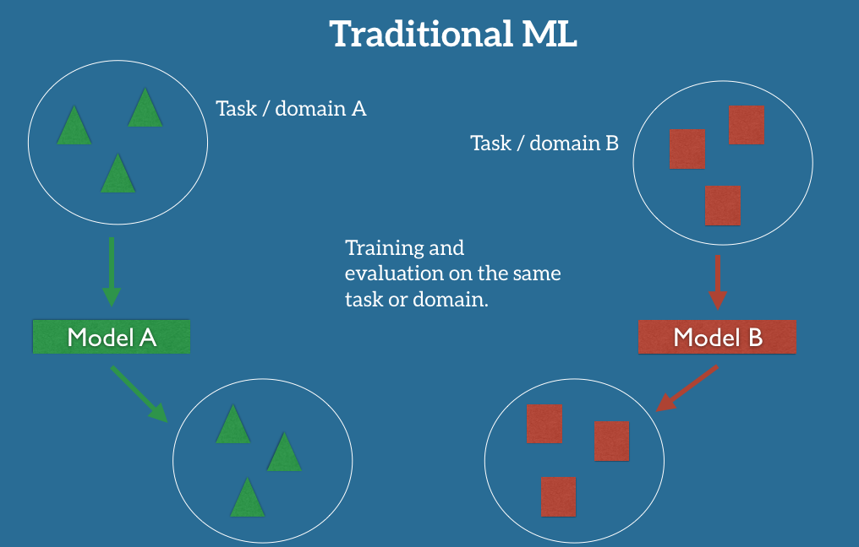
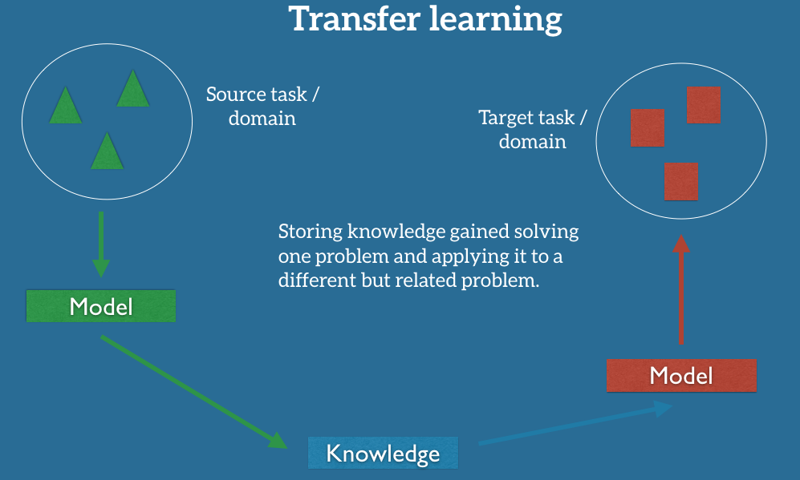
What is Transfer Learning?
http://ruder.io/transfer-learning/

Slide 4
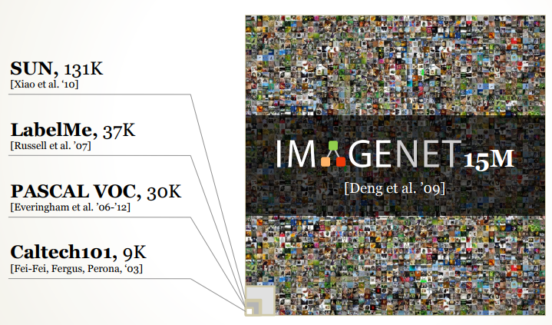
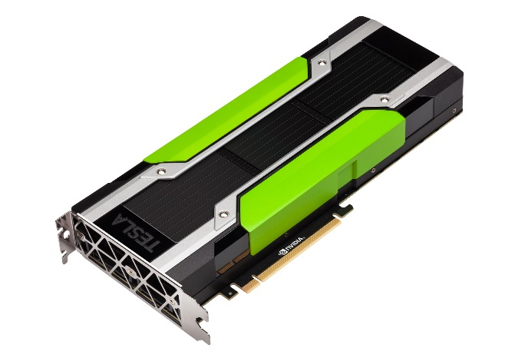
Why Transfer Learning?
Data
Gap between dataset and parameters
Most Computer Vison Problems dataset (5,000 images ~40,000images)
VGG16 parameters 138 millions
GPU
GeForce GTX 1080Ti $699
Tesla P100 PCI-E 16GB $7,374

Slide 5
ImageNet
ImageNet contains 1.2 million images with 1,000 categories
1,000 categories
PASCAL (2005): 20,000 images with 20 object classes
ImageNet Large Scale Visual Recognition Challenge (ILSVRC)
2010 ~ 2017
ILSVRC 2017 Workshop: Where have we been? Where are we going?
Object localization
Classification
Localization
Object detection
ILSVRC | Model | Classification Top-5 Error rate
2012 1st | AlexNet | 15.4%
2012 2nd |  | 26.2%
2013 | ZF Net | 11.2%
2014 1st | GoogLeNet | 6.7%
2014 2nd | VGGNet | 7.3%
2015 | ResNet (MS) | 3.5%
 | Human | 5.1%

Slide 6
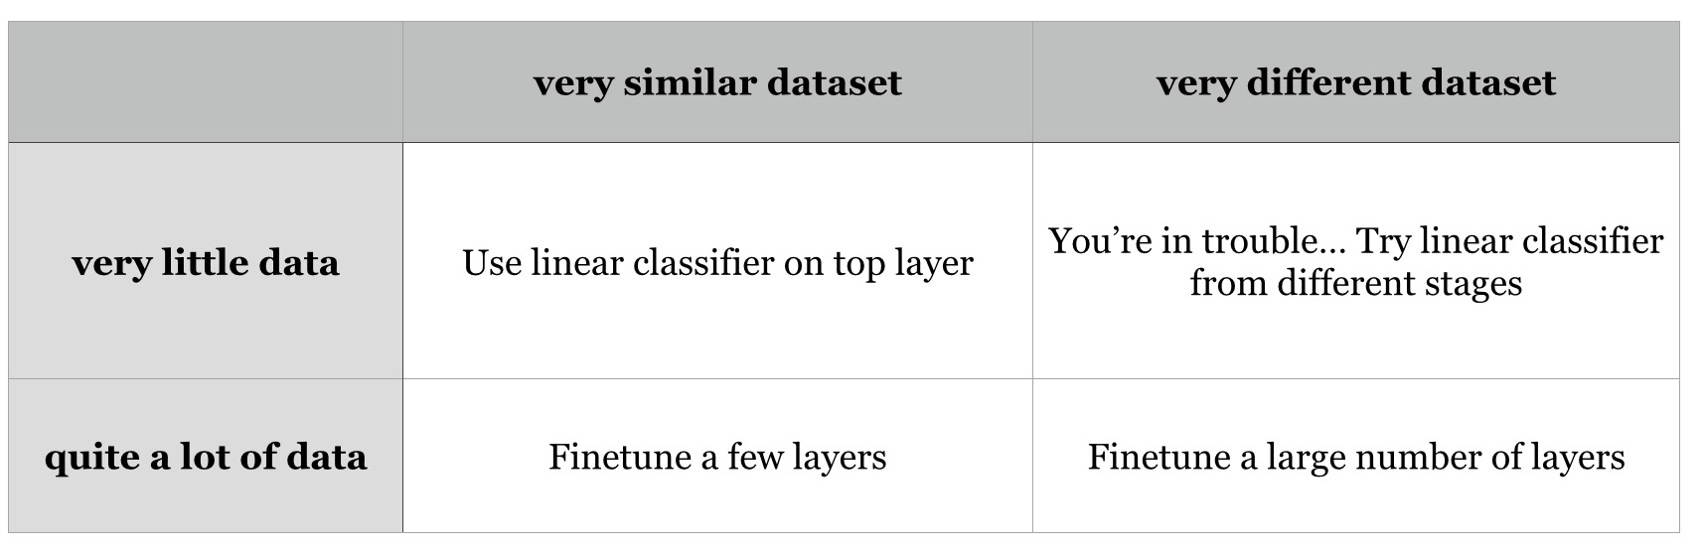
Four Major Scenarios
1
3
< 1k
2
4
http://lamda.nju.edu.cn/weixs/project/CNNTricks/CNNTricks.html

Slide 7
Four Major Scenarios
New dataset is small and similar to original dataset. Since the data is small, it is not a good idea to fine-tune the ConvNet due to overfitting concerns. Since the data is similar to the original data, we expect higher-level features in the ConvNet to be relevant to this dataset as well. Hence, the best idea might be to train a linear classifier on the CNN codes.
New dataset is large and similar to the original dataset. Since we have more data, we can have more confidence that we won’t overfit if we were to try to fine-tune through the full network.
New dataset is small but very different from the original dataset. Since the data is small, it is likely best to only train a linear classifier. Since the dataset is very different, it might not be best to train the classifier form the top of the network, which contains more dataset-specific features. Instead, it might work better to train the SVM classifier from activations somewhere earlier in the network.
New dataset is large and very different from the original dataset. Since the dataset is very large, we may expect that we can afford to train a ConvNet from scratch. However, in practice it is very often still beneficial to initialize with weights from a pretrained model. In this case, we would have enough data and confidence to fine-tune through the entire network.
http://cs231n.github.io/transfer-learning/

Slide 8
Four Major Scenarios - 1
similar dataset, very little data
Use linear classifier on top layer
Input
(28,28,3)
Output
Dense
(1000)
Conv2D
(28,28,32)
Conv2D
(14,14,32)
Conv2D
(7,7,64)
Dense
(2048)

Slide 9
Four Major Scenarios - 1
Remove top layer
similar dataset, very little data
Use linear classifier on top layer
Input
(28,28,3)
Output
Dense
(1000)
Conv2D
(28,28,32)
Conv2D
(14,14,32)
Conv2D
(7,7,64)
Dense
(2048)

Slide 10
Four Major Scenarios - 1
similar dataset, very little data
Use linear classifier on top layer
Referred as feature
Linear classifier
(SVM…)
Input
(28,28,3)
Conv2D
(28,28,32)
Conv2D
(14,14,32)
Conv2D
(7,7,64)
Dense
(2048)
Train linear classifier
Do not train anything, just predict

Slide 11
Four Major Scenarios - 2
similar dataset, a lot of data
Finetune a few layers
Input
(28,28,3)
Output
Dense
(1000)
Conv2D
(28,28,32)
Conv2D
(14,14,32)
Conv2D
(7,7,64)
Dense
(2048)

Slide 12
Four Major Scenarios - 2
similar dataset, a lot of data
Finetune a few layers
Input
(28,28,3)
Output
Dense
(2)
Conv2D
(28,28,32)
Conv2D
(14,14,32)
Conv2D
(7,7,64)
Dense
(2048)
Freeze lots of layers
Trainable = False
Finetune a few layers
Trainable = True

Slide 13
Four Major Scenarios - 3
different dataset, very little data
Try linear classifier from different stages
Input
(28,28,3)
Output
Dense
(1000)
Conv2D
(28,28,32)
Conv2D
(14,14,32)
Conv2D
(7,7,64)
Dense
(2048)

Slide 14
Four Major Scenarios - 3
Remove top layer
different dataset, very little data
Try linear classifier from different stages
Input
(28,28,3)
Output
Dense
(1000)
Conv2D
(28,28,32)
Conv2D
(14,14,32)
Conv2D
(7,7,64)
Dense
(2048)

Slide 15
Four Major Scenarios - 3
different dataset, very little data
Try linear classifier from different stages
Referred as feature
Linear classifier
(SVM…)
Input
(28,28,3)
Conv2D
(28,28,32)
Conv2D
(14,14,32)
Conv2D
(7,7,64)
Dense
(2048)
Train linear classifier
Do not train anything, just predict

Slide 16
Four Major Scenarios - 3
different dataset, very little data
Try linear classifier from different stages
Remove these layers
Linear classifier
(SVM…)
Input
(28,28,3)
Conv2D
(28,28,32)
Conv2D
(14,14,32)
Conv2D
(7,7,64)
Dense
(2048)

Slide 17
Four Major Scenarios - 3
different dataset, very little data
Try linear classifier from different stages
Referred as feature
Linear classifier
(SVM…)
Input
(28,28,3)
Conv2D
(28,28,32)
Conv2D
(14,14,32)
Dense
(2048)
Train linear classifier
Do not train anything, just predict

Slide 18
Four Major Scenarios - 3
different dataset, very little data
Try linear classifier from different stages
Remove more layers
Linear classifier
(SVM…)
Input
(28,28,3)
Conv2D
(28,28,32)
Conv2D
(14,14,32)
Conv2D
(7,7,64)
Dense
(2048)

Slide 19
Four Major Scenarios - 3
different dataset, very little data
Try linear classifier from different stages
Referred as feature
Linear classifier
(SVM…)
Input
(28,28,3)
Conv2D
(28,28,32)
Dense
(2048)
Train linear classifier
Do not train anything, just predict

Slide 20
Four Major Scenarios - 4
different dataset, a lot of data
Finetuen a large number of layers
Input
(28,28,3)
Output
Dense
(1000)
Conv2D
(28,28,32)
Conv2D
(14,14,32)
Conv2D
(7,7,64)
Dense
(2048)

Slide 21
Four Major Scenarios - 4
different dataset, a lot of data
Finetuen a large number of layers
Input
(28,28,3)
Input
(28,28,3)
Output
Dense
(2)
Conv2D
(7,7,64)
Conv2D
(7,7,64)
Dense
(2048)
Conv2D
(14,14,32)
Dense
(2048)
Conv2D
(28,28,32)
Conv2D
(14,14,32)
Conv2D
(28,28,32)
Freeze a few layers
Trainable = False
Finetune lots of layers
Trainable = True

Slide 22
Four Major Scenarios - 4
different dataset, a lot of data
Finetuen a large number of layers
Input
(28,28,3)
Input
(28,28,3)
Output
Dense
(2)
Conv2D
(7,7,64)
Conv2D
(7,7,64)
Dense
(2048)
Conv2D
(14,14,32)
Dense
(2048)
Conv2D
(28,28,32)
Conv2D
(14,14,32)
Conv2D
(28,28,32)
Finetune all layers
Trainable = True

Slide 23
More Examples
https://www.kaggle.com/abnera/transfer-learning-keras-xception-cnn
https://towardsdatascience.com/transfer-learning-using-keras-d804b2e04ef8
https://flyyufelix.github.io/2016/10/08/fine-tuning-in-keras-part2.html

Slide 24
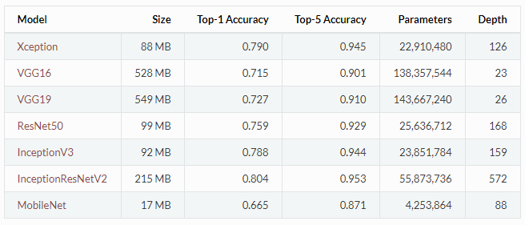
Pretrained model
Keras application
Xception w,h >= 71
VGG16, VGG19 w,h >= 48
ResNet50 w,h >= 197
InceptionV3 w,h >= 139
InceptionResNetV2 w,h >= 139
MobileNet w,h >= 32
ImageNet Pretrained Models

Slide 25
Pretrained model
Caffe
Model Zoo - A platform for third party contributors to share pre-trained caffe model
TensorFlow
VGG16
Inception V3
ResNet
Torch
LoadCaffe - Maintains a list of popular models like AlexNet and VGG .Weights ported from Caffe
MxNet
MxNet Model Gallery - Maintains pre-trained Inception-BN (V2) and Inception V3.
https://flyyufelix.github.io/2016/10/03/fine-tuning-in-keras-part1.html

Slide 26
Reference
A Comprehensive guide to Fine-tuning Deep Learning Models in Keras (Part I)
A Comprehensive guide to Fine-tuning Deep Learning Models in Keras (Part II)
Fine-tune Convolutional Neural Network in Keras with ImageNet Pretrained Models
Transfer Learning using Keras
CS231n Convolutional Neural Networks for Visual Recognition
Transfer Learning: Keras Xception CNN
Must Know Tips/Tricks in Deep Neural Networks

